Slide 1

DriverPass System Analysis
Elliot Putnam
Notes:
[No speaker notes required for this slide.]

Slide 2

System Requirements
Functional
The system shall provide users a way to securely sign in
The system shall provide exams related to current DMV criteria
Non-Functional
The system should require adequate space for user and system data
The system should garner the ability to users to update their account details
Notes:
[In your speaker notes, include an explanation of the different requirements you determined for DriverPass’s system. What are the functional requirements you selected to describe? What are the nonfunctional requirements you selected to describe? Be sure to explain how these requirements meet DriverPass’s needs.]

Slide 3
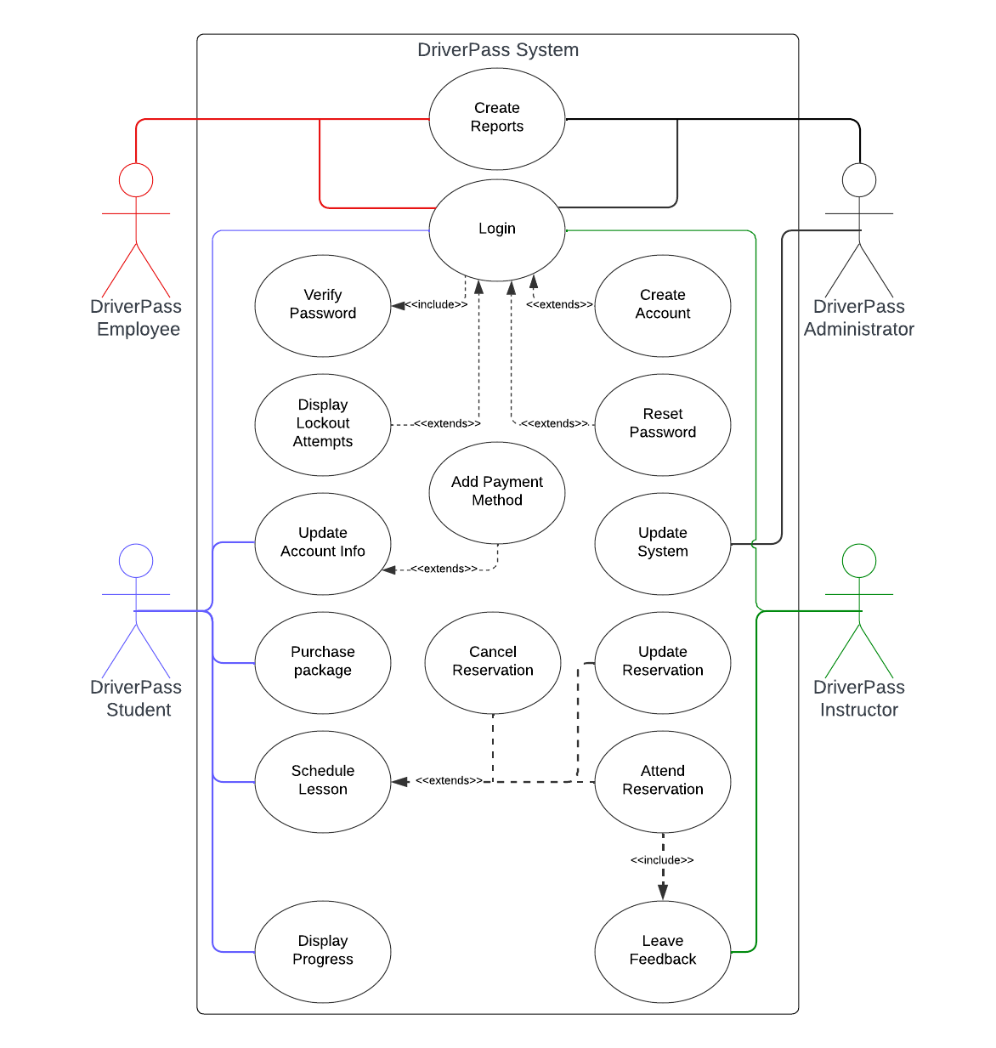
Use Case Diagram
[Insert your use case diagram here.]
Notes:
[Explain your diagram. Who are the different actors in the system? What are the different use cases? How did you account for DriverPass’s needs in your design? In your explanation, keep your audience in mind. Avoid the use of terms like “actors” and “use cases” in your explanation.]

Slide 4
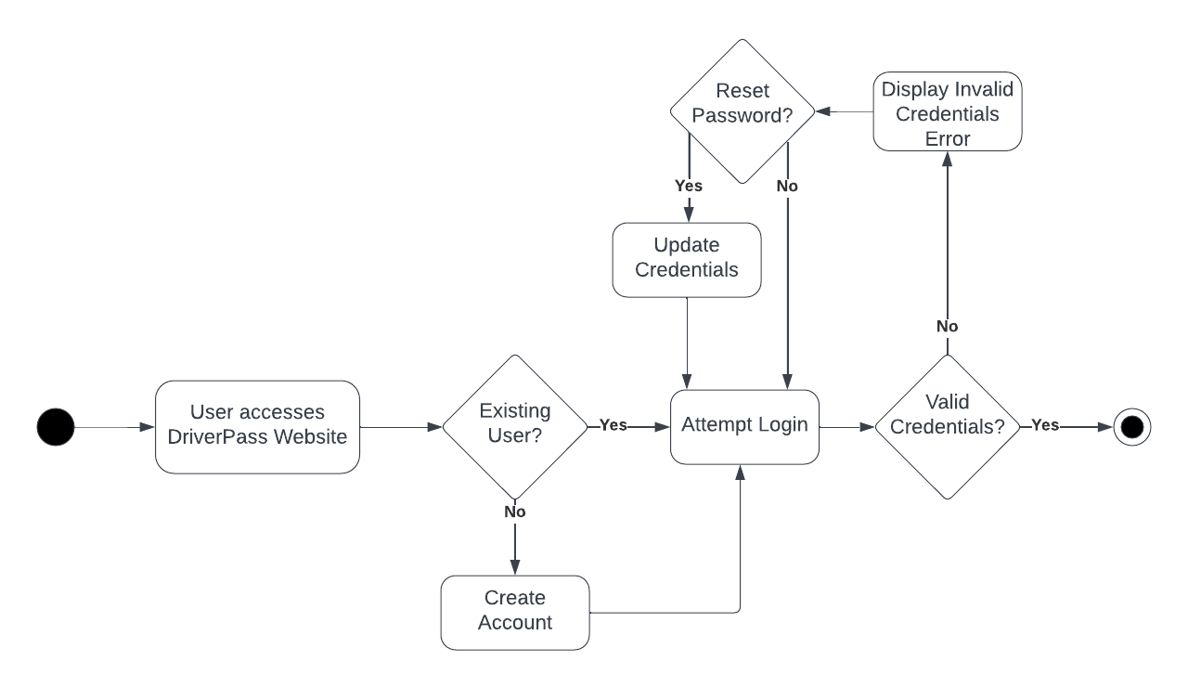
Activity Diagram
[Insert one of your activity diagrams here.]
Notes:
[Explain your diagram. Which use case are you breaking down? What are the steps for this use case? How did you account for DriverPass’s needs in your design? In your explanation, keep your audience in mind. Avoid the use of technical terms such as “nodes,” “control flows,” and so on.]

Slide 5
Security
Users are required to authenticate their connected email address
Users require complex passwords with upper case, symbols, numbers, and a minimum of 12 characters
Login attempt limits
Encryption between client and server
Notes:
[How did you consider security in your design? In your explanation, keep your audience in mind by avoiding the use of technical terms.]

Slide 6
System Limitations
The system assumes users will have moderate to fast connection speeds
The system is limited to major browsers (chrome, edge, firefox, safari)
The system can only work if users have access to an email account
Notes:
[What are the limitations of your design? In your explanation, keep your audience in mind by avoiding the use of technical terms.]

